Slide 1

Classifying Spoken Accents: A Proof of Concept
Stephen Kaplan, August 2020

Slide 2

Motivation
Multinational companies have a global costumer base.
Companies receive support calls from people with a diversity of spoken accents.
Calls are successful and support tickets are closed when the employee and customer can clearly communicate.
Goal: Develop a proof of concept for technology that can automatically match callers with customer support agents that have similar accents.

Slide 3
Motivation
Multinational companies have a global costumer base.
Companies receive support calls from people with a diversity of spoken accents.
Calls are successful and support tickets are closed when the employee and customer can clearly communicate.
Goal: Develop a proof of concept for technology that can automatically match callers with customer support agents that have similar accents.

Slide 4
Motivation
Multinational companies have a global costumer base.
Companies receive support calls from people with a diversity of spoken accents.
Calls are successful and support tickets are closed when the employee and customer can clearly communicate.
Goal: Develop a proof of concept for technology that can automatically match callers with customer support agents that have similar accents.

Slide 5
Motivation
Multinational companies have a global costumer base.
Companies receive support calls from people with a diversity of spoken accents.
Calls are successful and support tickets are closed when the employee and customer can clearly communicate.
Goal: Develop a proof of concept for technology that can automatically match callers with customer support agents that have similar accents.

Slide 6
Scope: Proof of Concept
Audio Files
Initial Data Available: 330 audio recordings of spoken accents from the US, UK, Italy, Germany, Spain, and France.*
Create machine-learning model that can classify audio recordings as American or not-American.
Shorter Term Future Goal: Classify among 6 accents
Long Term Future Goal: Classify ANY accent
*Fokoue, E. (2020). UCI Machine Learning Repository. Irvine, CA: University of California, School of Information and Computer Science.
Extracted “MFCC” Features
ML Model
American Accent
Other

Slide 7
Scope: Proof of Concept
Audio Files
Initial Data Available: 330 audio recordings of spoken accents from the US, UK, Italy, Germany, Spain, and France.
Create machine-learning model that can classify audio recordings as American or not-American.
Shorter Term Future Goal: Classify among 6 accents
Long Term Future Goal: Classify ANY accent
Extracted “MFCC” Features
ML Model
American Accent
Other

Slide 8
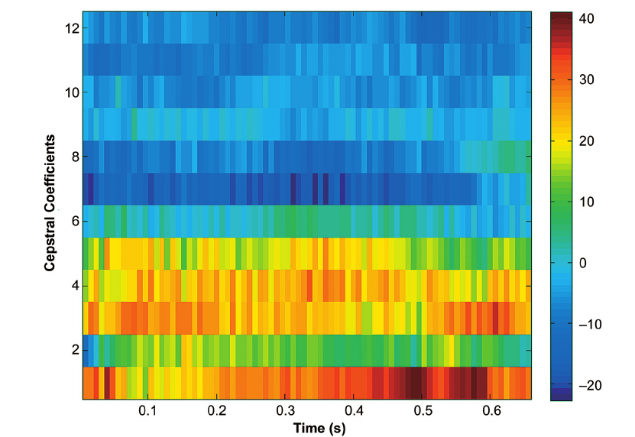
Choosing Measure of Success
Input Data: Mel-frequency Cepstral Coefficients (MFCC) represent the “energy spectral density” of an audio signal….?
In other words, the data doesn’t mean anything to most people.
We care about the prediction accuracy.
No preference on successfully predicting one thing or another.
“Huh?” - everyone

Slide 9
Choosing Measure of Success
Input Data: Mel-frequency Cepstral Coefficients (MFCC) represent the “energy spectral density” of an audio signal….?
In other words, the data doesn’t mean anything to most people.
We care about the prediction accuracy.
No preference on successfully predicting one thing or another.
“Huh?” - everyone

Slide 10
Choosing Measure of Success
Input Data: Mel-frequency Cepstral Coefficients (MFCC) represent the “energy spectral density” of an audio signal….?
In other words, the data doesn’t mean anything to most people.
We care about the prediction accuracy.
No preference on successfully predicting one thing or another.
“Huh?” - everyone

Slide 11
Choosing Measure of Success
Input Data: Mel-frequency Cepstral Coefficients (MFCC) represent the “energy spectral density” of an audio signal….?
In other words, the data doesn’t mean anything to most people.
We care about the prediction accuracy.
No preference on successfully predicting one thing or another.
“Huh?” - everyone

Slide 12


Technicals
Feature Engineering: Simply removing x9 yielded the best results
Model used: Ensemble, composed of:
KNN (n_neighbors = 6)
Logistic Regression ( C = 0.1, L1 regularization)
Selected based on best overall ROC AUC score and least overfitting

Slide 13
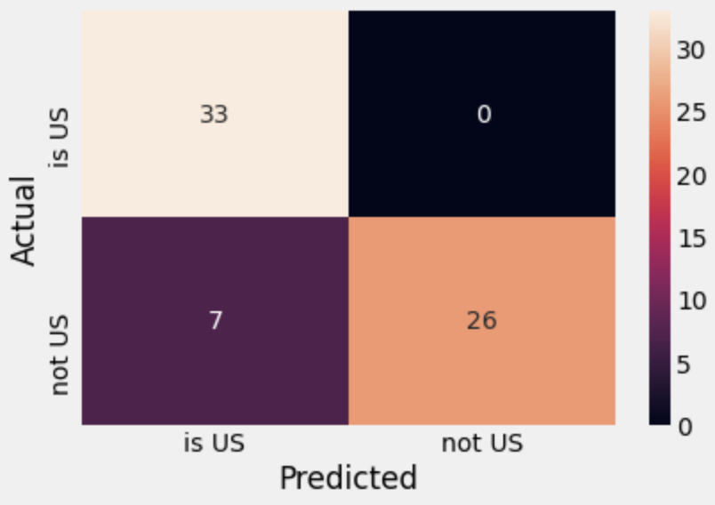
How did the proof of concept do?
Accuracy = 89%
Original research paper on this topic from 2014 achieved 85% accuracy using the same data.
0 False Positives
Some False Negatives

Slide 14
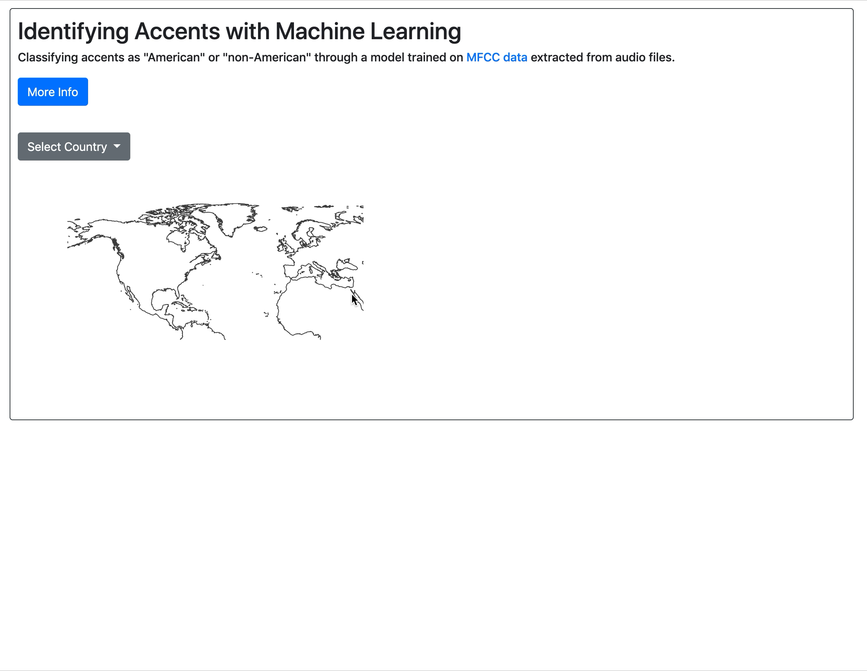
Demo: Data Exploration Tool
Application created using the Flask framework.

Slide 15
Takeaway & Future Work
Accents can be classified automatically and nearly instantaneously using machine learning techniques with a fairly high accuracy.
Future Work
Expand model from binary classification to classifying multiple accents.
Process more audio data to improve data set.
Research improvement of technical support (# tickets closed per quarter) after using automatic accent matching technology.

